Slide 1
Lecture: 4
Finite Automata continued

Slide 2
Nondeterministic Finite Automaton
Does not require input symbols for state transitions
Capable of transitioning to multiple state for a given input symbol

Slide 3
Nondeterministic Finite Automaton (NFA)
NFA can also represents a Regular Language, so what differentiate it from DFA?
DFA only has one transition arrow for a symbol, but the NFA can have more than one transition arrow for a symbol
DFA only has alphabet symbols on transition arrow, but the NFA can have ε on the transition arrow
When a NFA reads an input symbol and there are multiple transitions with labeled with that symbol
It splits into multiple copies of itself, and
follows all possibilities in parallel.

Slide 4
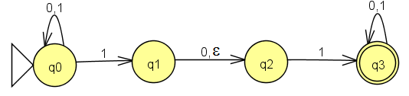
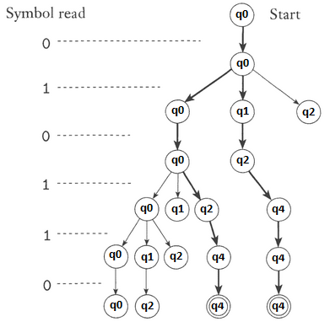
NFA Example
Above is an NFA because
at q0 there exist two directions for 1
at q1 the ε transition exits
What will the NFA do with string 010110?

Slide 5
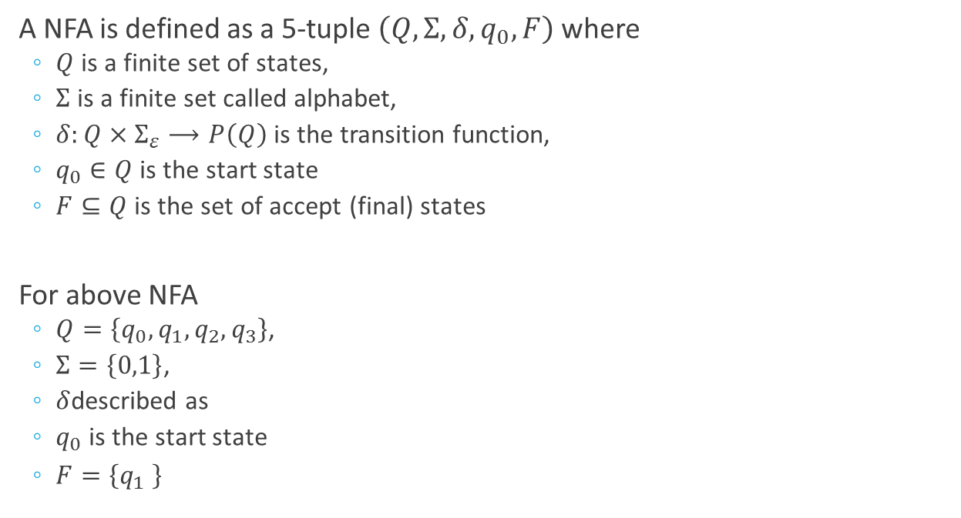
NFA Formal Definition
A NFA is defined as a 5-tuple $\left(Q,Σ,δ,q_{0},F\right)$ where
$Q$ is a finite set of states,
$Σ$ is a finite set called alphabet,
$δ:Q×Σ_{ε}⟶P\left(Q\right)$ is the transition function,
$q_{0}∈Q$ is the start state
$F⊆Q$ is the set of accept (final) states
For above NFA
$Q=\left\{q_{0},q_{1},q_{2},q_{3}\right\}$,
$Σ=\left\{0,1\right\}$,
$δ$described as
$q_{0}$ is the start state
$F=\left\{q_{1} \right\}$
δ | 0 | 1 | ε
q0 | {q0} | {q0,q1} | ∅
q1 | {q2} | ∅ | {q2}
q2 | ∅ | {q3} | ∅
q3 | {q3} | {q3} | ∅
$$M=\left(\left\{q_{0},q_{1},q_{2},q_{3}\right\},\left\{0,1\right\},δ, q_{0},\left\{q_{1}\right\}\right)$$

Slide 6
NFAs and DFAs Equivalence
Every NFA has an equivalent DFA

Slide 7
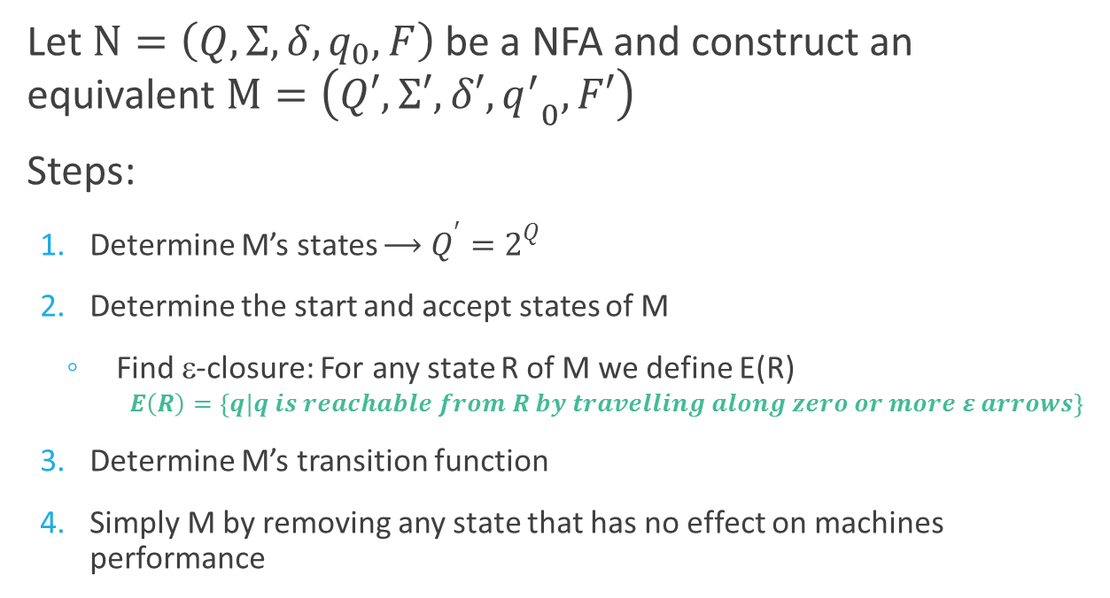
NFAs and DFAs Equivalence
Let $N=\left(Q,Σ,δ,q_{0},F\right)$ be a NFA and construct an equivalent $M=\left(Q′,Σ′,δ′,{q^{′}}_{0},F′\right)$
Steps:
Determine M’s states $⟶Q^{′}=2^{Q}$
Determine the start and accept states of M
Find ε-closure: For any state R of M we define E(R)
$$E\left(R\right)=\left\{q|q is reachable from R by travelling along zero or more ε arrows\right\}$$
Determine M’s transition function
Simply M by removing any state that has no effect on machines performance

Slide 8
NFA to DFA Conversion
Example 1

Slide 9
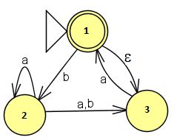
NFA to DFA Conversion
Given $N=\left(\left\{1,2,3\right\},\left\{a,b\right\},δ,1,\left\{1\right\}\right)$, construct $M=\left(Q′,Σ′,δ′,{q^{′}}_{0},F′\right)$
δ′ | a | b
∅ | ∅ | ∅
{1} | ∅ | {2}
{2} | {2,3} | {3}
{3} | {1,3} | ∅
{1,2} | {2,3} | {2,3}
{1,3} | {1,3} | {2}
{2,3} | {1,2,3} | {3}
{1,2,3} | {1,2,3} | {2,3}
ε({1}) = {1,3}
{1,3} is the start state

Slide 10
NFA to DFA Conversion
Given $N=\left(\left\{1,2,3\right\},\left\{a,b\right\},δ,1,\left\{1\right\}\right)$, construct $M=\left(Q′,Σ′,δ′,{q^{′}}_{0},F′\right)$
δ′ | a | b
∅ | ∅ | ∅
{1} | ∅ | {2}
{2} | {2,3} | {3}
{3} | {1,3} | ∅
{1,2} | {2,3} | {2,3}
{1,3} | {1,3} | {2}
{2,3} | {1,2,3} | {3}
{1,2,3} | {1,2,3} | {2,3}
States {1} and {1,2} does not appear in any transition. They can be removed
{1} was originally the accept state
With ε({1}) = {1,3} accept states are: {1,3} and {1,2,3}
{1,3} is the start state based on the ε-closure

Slide 11
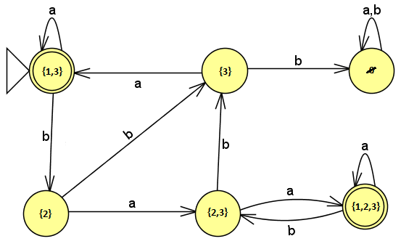
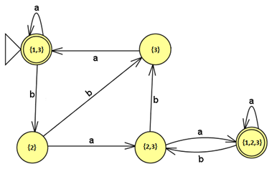
NFA to DFA Conversion
You can remove states that are unreachable and states that cannot reach an accepting state
Simplified DFA

Slide 12
NFA to DFA Conversion
Example 2

Slide 13
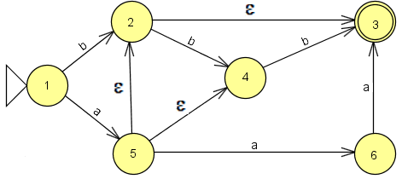
NFA to DFA Conversion
δ′ | a | b
{1} | {2,3,4,5} | {2,3}
{2,3,4,5} | {6} | {3,4}
{2,3} | ∅ | {4}
{6} | {3} | ∅
{3,4} | ∅ | {3}
∅ | ∅ | ∅
{4} | ∅ | {3}
{3} | ∅ | ∅
Define ε-closure
ε({2}) = {2,3}
ε({5}) = {2,3,4,5}
Start state is {1}
Final states are:
{2,3,4,5}, {2,3}, {3,4}, {3}

Slide 14
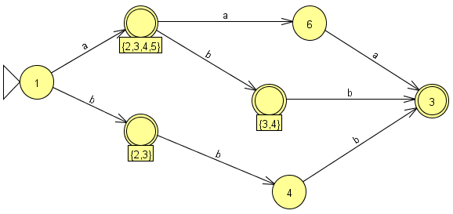
NFA to DFA Conversion
Final DFA

Slide 15
Regular Expressions and Finite Automata Equivalence

Slide 16
Regular Expressions and Finite Automata Equivalence
Theorem: A language is regular if and only if some regular expression describes it.
Lemma: If a language is described by a regular expression, then it is regular.
Proof Idea: Inductively convert a given regular expression to an NFA.

Slide 17
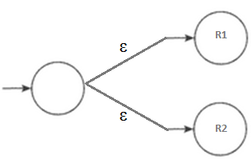


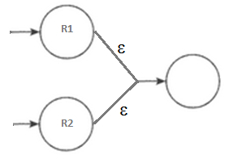

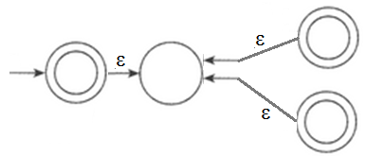
Converting Res to NFAs: Formal Definitions
R = a for some a in Σ
R = ε
R = ∅
R = R₁∪R₂
R = R₁•R₂
R = R*₁

Slide 18
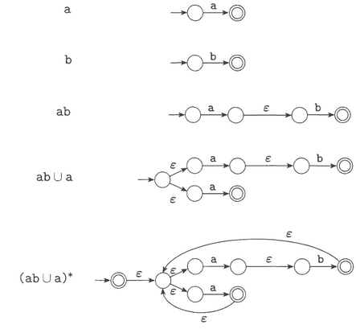
Converting Res to NFAs:
Convert (ab ∪ a)*

Slide 19
Converting DFAs to Res
To convert a DFA into an equivalent expression
Convert DFA into a generalized nondeterministic finite automaton (GNFA), then
Convert GNFA into a RE
What is a GNFA?
An NFA which may have any regular expressions on transition arrows
Reads blocks of symbols, not necessarily a symbol at a time
Like an NFA has several ways to process an input string
It only has a single accept state, which is not the same as the start state

Slide 20
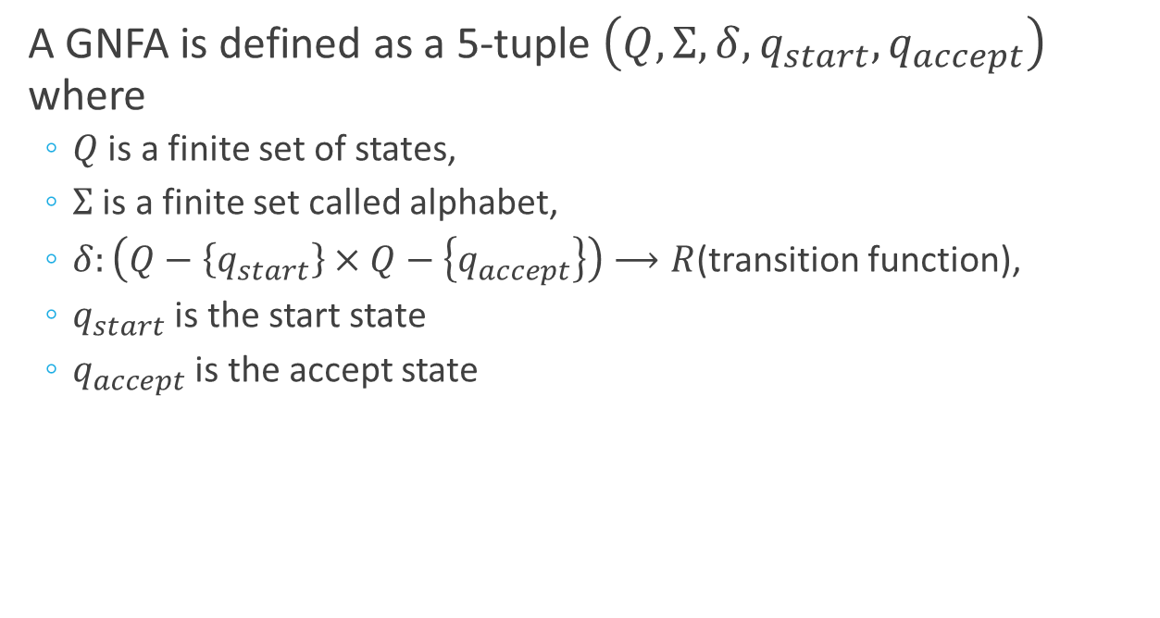
Converting DFAs to Res: GNFA Formal Definition
A GNFA is defined as a 5-tuple $\left(Q,Σ,δ,q_{start},q_{accept}\right)$ where
$Q$ is a finite set of states,
$Σ$ is a finite set called alphabet,
$δ:\left(Q−\left\{q_{start}\right\}×Q−\left\{q_{accept}\right\}\right)⟶R$(transition function),
$q_{start}$ is the start state
$q_{accept}$ is the accept state

Slide 21
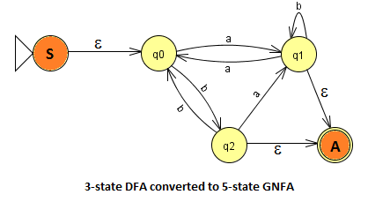
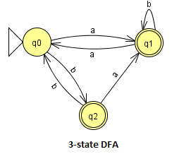
Converting DFAs to Res
To convert a DFA into a GNFA, simply add
new start state with ε on the transition arrow to old start state
new accept state with ε on the transition arrows to all old accept states

Slide 22
Converting DFAs to Res
To convert a GNFA into a RE delete states one by one, until only the new start state and accept state are left
After each deletion update the remaining transition arrows with the regular expression from the label of the generalized transition

Slide 23
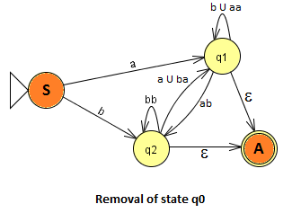
Converting DFAs to Res
Remove state q0: we have to account for paths
S-q0-q1 ⇒ a
S-q0-q2 ⇒ b
q1-q0-q2 ⇒ ab
q2-q0-q1 ⇒ ba
(q1-q0)* ⇒ aa
(q2-q0)* ⇒ bb

Slide 24
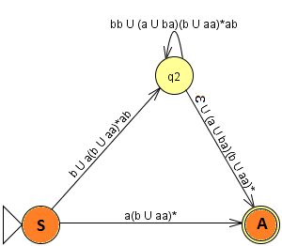
Converting DFAs to Res
Remove state q1: we have to account for paths
S-q1-A ⇒ a(b∪aa)*
S-q1-q2 ⇒ a(b∪aa)*ab
q2-q1-A ⇒ (a∪ba)(b∪aa)*
(q2-q1)* ⇒ (a∪ba)(b∪aa)*ab

Slide 25

Converting DFAs to Res
Remove state q2: we have to account for paths
S-q2-A ⇒ b∪a(b∪aa)*ab (bb∪(a∪ba)(b∪aa)*ab)* ε∪(a∪ba)(b∪aa)*

Slide 26
Reference:
Introduction to Theory of Computation (Michael Sipser)
Chapter 1: Regular Languages

